Slide 1
IE 260 Lecture 7: Binary Tree
Il-Chul Moon
Department of Industrial and Systems Engineering
KAIST

Slide 2
Short recap

Slide 3
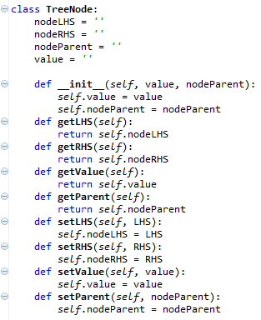
Implementation of tree node
Has three references
Left hand side (LHS)
Right hand side (RHS)
Its own value
Its parent node
Not implemented here, but
LHS stores
Values have lower than its own value
RHS stores
Values have higher than its own value
Just as we all know that the department stores do not have a restroom on the first floor
Other than four references,
Simple get/set methods
What are the get/set methods?
Coming from encapsulation
Four references

Slide 4
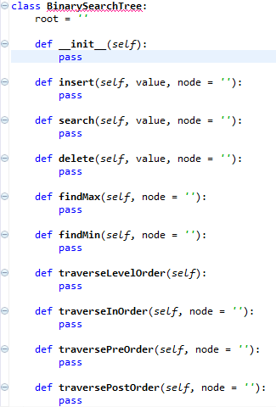
Implementation of BST
Tree instance
A (root)
B
C
D
E
F
BST handles the data stored through its root
Root has its own value
Tree instance access to the root
Only through the root, the tree instances access to the descendant nodes of the root

Slide 5
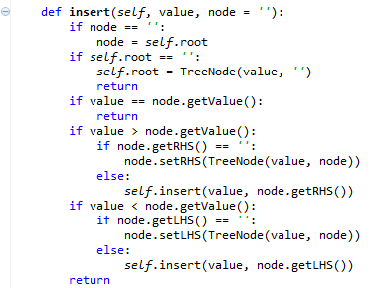
Insert operation of binary search tree
Insertion operation
Retrieve the current node value
If the value is equal to the value to insert
Return already there!
If the value is smaller than the value to insert
If there is a node in the right hand-side (RHS), then move to the RHS node (Recursion)
If there is no node in RHS, create a RHS node with the value to insert
If the value is larger than the value to insert
If there is a node in the left hand-side (LHS), then move to the LHS node (Recursion)
If there is no node in LHS, create a LHS node with the value to insert
Insert numbers: 3, 2, 0, 5, 7, 4…..
3
2
5
0
4
7

Slide 6
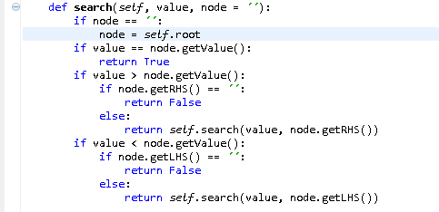
Search operation of binary search tree
Search operation
Retrieve the current node value
If the value is equal to the value to search
Return TRUE
If the value is smaller than the value to search
If there is a node in the right hand-side (RHS), then move to the RHS node (Recursion)
If there is no node in RHS, return FALSE
If the value is larger than the value to search
If there is a node in the left hand-side (LHS), then move to the LHS node (Recursion)
If there is no node in LHS, return FALSE
Find 4 in the BST
3
2
5
0
4
7

Slide 7
Delete operation of binary search tree (1)
3
First, you need to find the node to delete through recursions
Three deletion cases
Case 1: deleting a node with no children
Just remove the node by modifying its parent
Case 2: deleting a node with one child
Replace the node with the child
Case 3: deleting a node with two children
Find either
A maximum in the LHS or A minimum in the RHS
Substitute the node to delete with the found value
Delete the found node in the LHS or the RHS
2
5
0
4
7
Case 1: Just Remove ‘0’
3
2
5
0
4
7
Case 2: Replace ‘2’ with ‘0’

Slide 8
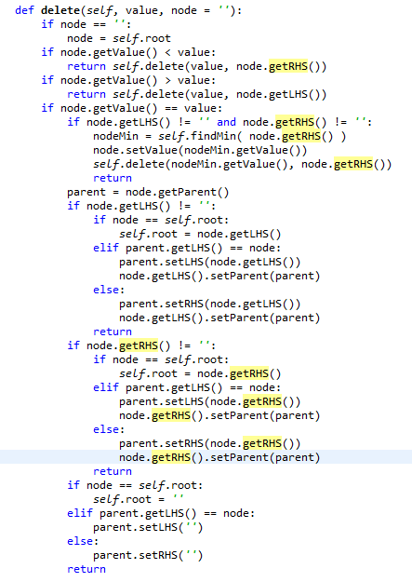
Delete operation of binary search tree (2)
4
2
2
5
0
5
0
7
4
7
Delete ‘4’ in RHS
Delete ‘2’ in LHS
4
2
2
5
2
5
0
4
7
0
4
7
3
Replace ‘3’ with ‘2’
Replace ‘3’ with ‘4’
2
5
0
4
7
Case 3: Replace ‘3’ with ‘X’

Slide 9
Tree traversing
Inserting 3, 2, 0, 5, 7, 4, 6, 1, 9, 8
Tree
Complicated than a list
Multiple ways to show the entire dataset
If it were a list
Just show the values from the beginning to the end
Since this is a BST
You have to choose what to show at a time
The value in LHS
The value in RHS
The value that you have
Hence there are multiple traversing approaches
LHS
RHS
Level 1
3
Level 2
2
5
Level 3
0
4
7
Level 4
1
6
9
Level 5
8

Slide 10
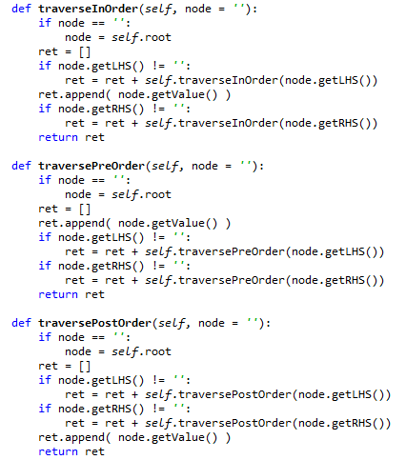
Depth first traverse
Pre-order traverse
Order: Current, LHS, RHS in Recursion
3, 2, 0, 1, 5, 4, 7, 6, 9, 8
In-order traverse
Order: LHS, Current, RHS in Recursion
0, 1, 2, 3, 4, 5, 6, 7, 8, 9
Post-order traverse
Order: LHS, RHS, Current in Recursion
1, 0, 2, 4, 6, 8, 9, 7, 5, 3
3
2
5
0
4
7
1
6
9
8

Slide 11
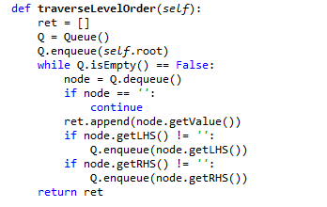
Breadth first traverse
3
Queue-based level-order traverse
3, 2, 5, 0, 4, 7, 1, 6, 9, 8
Enqueue the root
While until queue is empty
Current = Dequeue one element
Print current
If Current’s LHS exist
Enqueue current.LHS
If Current’s RHS exist
Enqueue current.RHS
2
5
0
4
7
1
6
9
Current | Queue
 | 3
3 | 2, 5
2 | 5, 0
5 | 0, 4, 7
0 | 4, 7, 1
4 | 7, 1
7 | 1, 6, 9
1 | 6, 9
6 | 9
9 | 8
8
8

Slide 12
Offline class plan

Slide 13

Party Classification
Political party
Voting record
https://archive.ics.uci.edu/ml/datasets/congressional+voting+records
Attribute
Class
Democrat or Republican
Features (? means no record)
handicapped-infants: 2 (y,n)
water-project-cost-sharing: 2 (y,n)
adoption-of-the-budget-resolution: 2 (y,n)
physician-fee-freeze: 2 (y,n)
el-salvador-aid: 2 (y,n)
religious-groups-in-schools: 2 (y,n)
anti-satellite-test-ban: 2 (y,n)
aid-to-nicaraguan-contras: 2 (y,n)
mx-missile: 2 (y,n)
immigration: 2 (y,n)
synfuels-corporation-cutback: 2 (y,n)
education-spending: 2 (y,n)
superfund-right-to-sue: 2 (y,n)
crime: 2 (y,n)
duty-free-exports: 2 (y,n)
export-administration-act-south-africa: 2 (y,n)
Can we classify the allegiance to the political party with the voting record? And How?

Slide 14
Decision Tree
Sky | Temp | Humid | Wind | Water | Forecst | EnjoySpt
Sunny | Warm | Normal | Strong | Warm | Same | Yes
Sunny | Warm | High | Strong | Warm | Same | Yes
Rainy | Cold | High | Strong | Warm | Change | No
Sunny | Warm | High | Strong | Cool | Change | Yes
We need a better learning method
We need to have more robust methods given the noises
We need to have more concise presentations of the hypotheses
One alternative is a decision tree
<Sunny, ?,?,?,?,?>
Sky
Rainy
Sunny
No
Yes
Sky
<Sunny, Warm, ?, Strong, ?, ?>
Rainy
Sunny
No
Temp
Only one potential decision tree corresponding to the hypothesis
Cold
Warm
No
Wind
Light
Strong
Yes
No

Slide 15

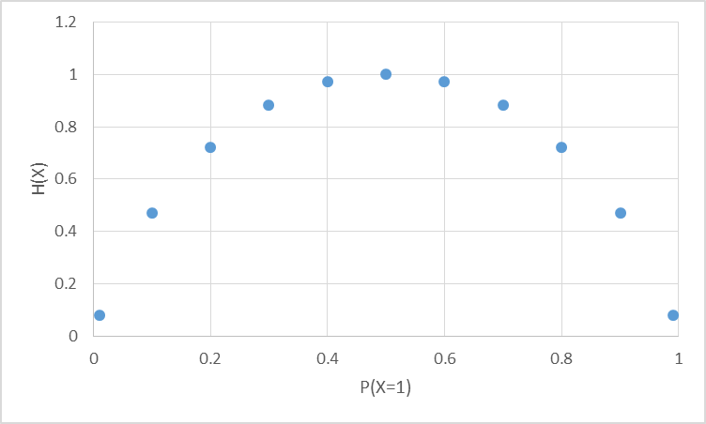
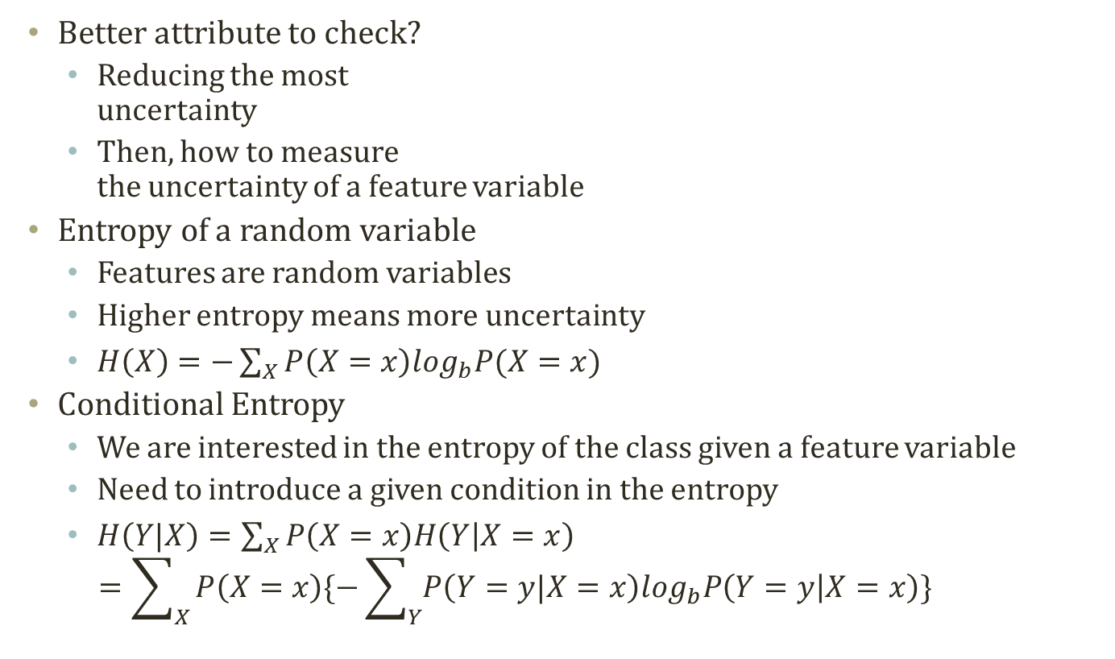
Entropy
Most random case
Better attribute to check?
Reducing the most uncertainty
Then, how to measure the uncertainty of a feature variable
Entropy of a random variable
Features are random variables
Higher entropy means more uncertainty
$H\left(X\right)=−\sum_{X}{P\left(X=x\right)\log_{b}P(X=x)}$
Conditional Entropy
We are interested in the entropy of the class given a feature variable
Need to introduce a given condition in the entropy
$H\left(Y|X\right)=\sum_{X}{P\left(X=x\right)H\left(Y | X=x\right)}$ $=\sum_{X}{P\left(X=x\right)\{−\sum_{Y}{P\left(Y=y|X=x\right)\log_{b}P\left(Y=y | X=x\right)}\}}$
All instances are X=0
All instances are X=1

Slide 16
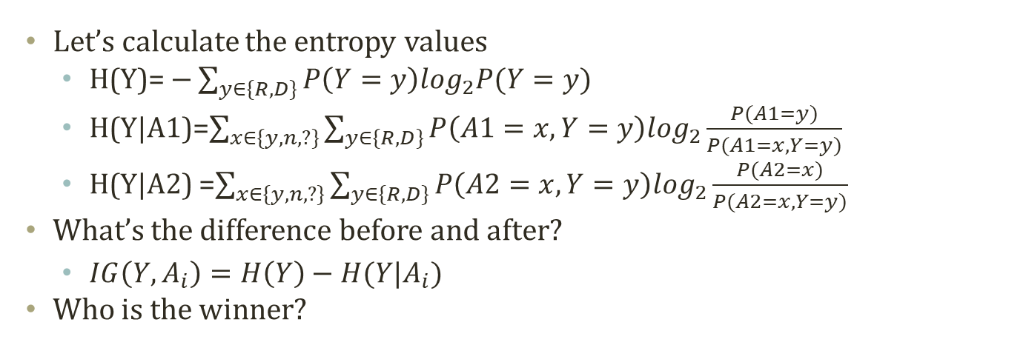
Information Gain
Entropy Before Decision Node
A1 (168R,267D)
A2 (168R,267D)
y
n
?
y
n
?
31R,156D
134R,102D
3R,9D
75R,120D
73R,119D
20R,28D
Entropy After Decision Node A1
Entropy After Decision Node A9
Let’s calculate the entropy values
H(Y)= $−\sum_{y∈\{R,D\}}{P\left(Y=y\right)\log_{2}P(Y=y)}$
H(Y|A1)=$\sum_{x∈\{y,n,?\}}{\sum_{y∈\{R,D\}}{P\left(A1=x,Y=y\right)\log_{2}\frac{P(A1=y)}{P(A1=x,Y=y)}}}$
H(Y|A2) =$\sum_{x∈\{y,n,?\}}{\sum_{y∈\{R,D\}}{P\left(A2=x,Y=y\right)\log_{2}\frac{P(A2=x)}{P(A2=x,Y=y)}}}$
What’s the difference before and after?
$IG\left(Y,A_{i}\right)=H\left(Y\right)−H(Y|A_{i})$
Who is the winner?

Slide 17
Top-Down Induction Algorithm
Classify the majority cases in the leaf
Split the node until there is only type
Many, many variations in learning a decision tree
ID3, C4.5 CART….
One example: ID3 algorithm
ID3 algorithm
Create an initial open node
Put instances in the initial node
Repeat until no open node
Select an open node to split
Select a best variable to split
For values of the selected variable
Sort instances with the value of the selected variable
Put the sorted items under the branch of the value of the variable
If the sorted items are all in one class
Close the leaf node of the branch
A1 (168R,267D)
y
n
?
31R,156D
134R,102D
3R,9D
A1 (168R,267D)
y
n
?
A2 (31R,156D)
134R,102D
3R,9D
y
n
?
16R,72D
11R,71D
4R,13D

Slide 18
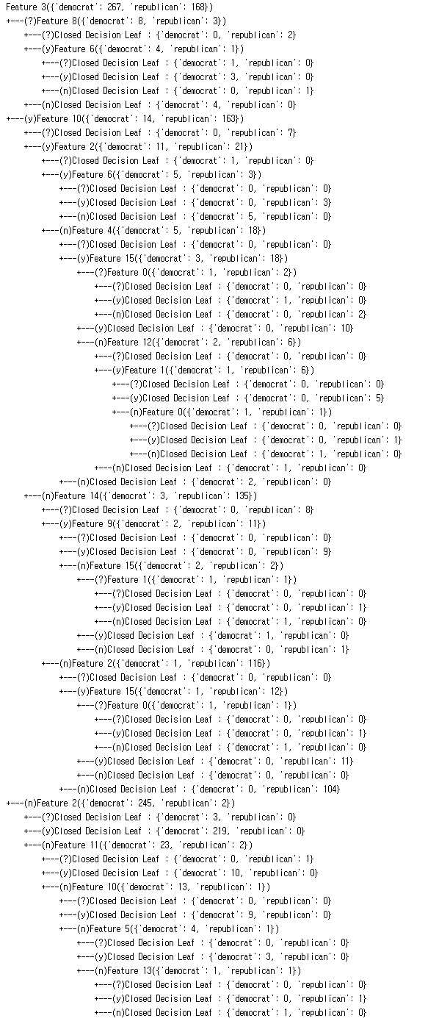
If you want more….

Slide 19
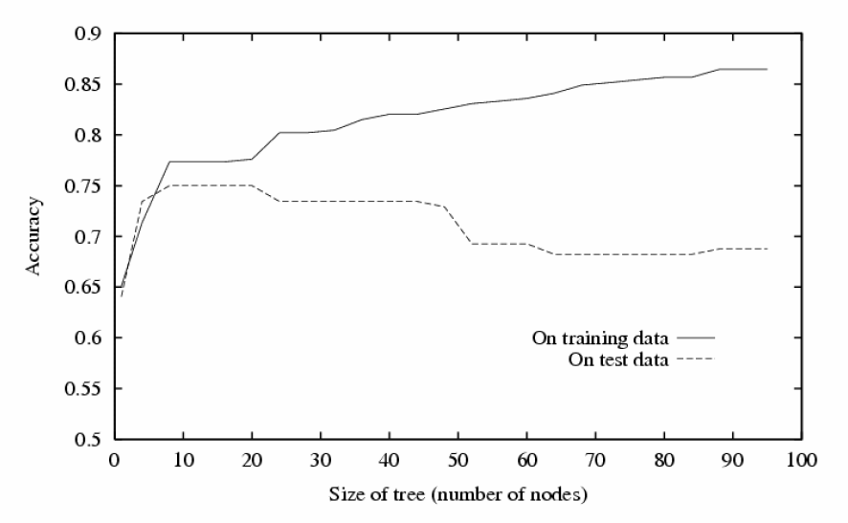
Problem of Decision Tree
Typical result of decision tree
We did better in the given dataset!
Only in the given experience, a.k.a. Training dataset
What if we deploy the created decision tree in the field?
World has so much noise and inconsistencies.
The training dataset will not be a perfect sample of the real world
Noise
Inconsistencies
Should have stopped here!
Knowing when to stop is a pretty difficult task. How to do it?
- Pruning by divided dataset?
- Path length penalty?

Slide 20
To-Dos
We are going to complete a decision tree
Use recursion to perform ID3 algorithm
Follow the tree structure to classify an instance
To-dos
Read the code in “voterecord.py” and “decisiontreenode.py”
To-do 1: complete “performID3”
How to start the recursion?
What is the condition of no-split?
How to perform the recursion?
To-do 2: complete “classify”
What is the decision node to start?
How to find the next node to follow?
How to recognize the node to stop?

Slide 21
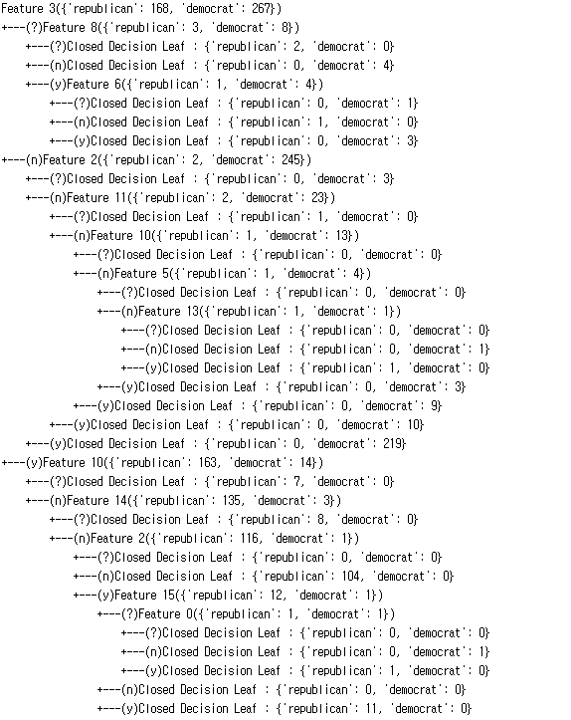
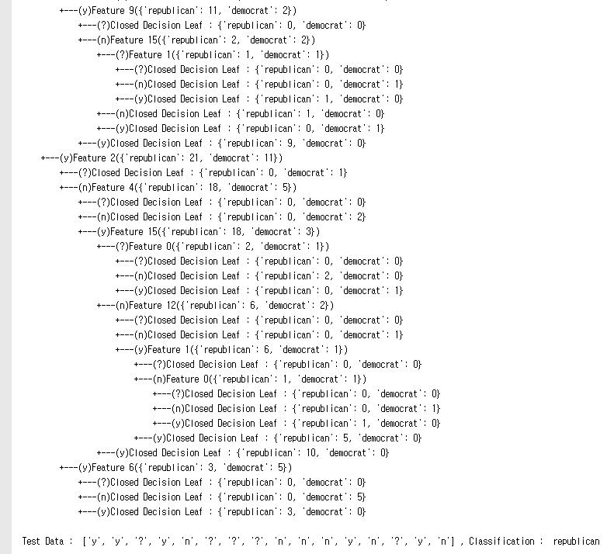
Execution Result
When you complete the codes, you are expected to see the below results.
Execute ‘decisiontree.py’

